Slide 1
PROGRESS OVERVIEW
Cloud-Native AI Operations Agent
for CEM–CVM Intelligence
An Autonomous Agent That Detects, Decides, and Acts
ADN
HCS-Ready
Architecture
Tunisie Telecom
Real Data
LEVEL 4
Student
Institution
Host
Date
Souhayl Guenichi
ESPRIT
Huawei Tunisia – Cloud Team
March 2026

Slide 2



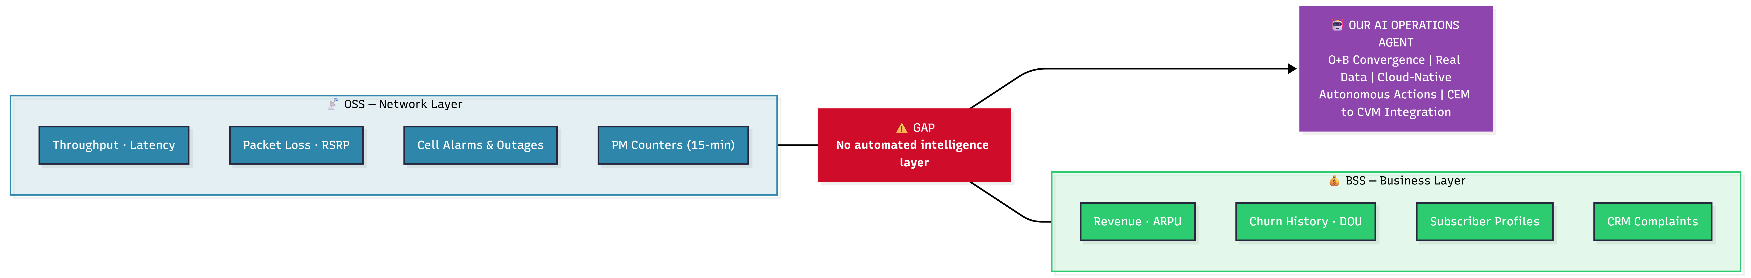
The Problem: Two Data Worlds That Never Talk
OSS — Network Layer
BSS — Business Layer
GAP
Throughput · Latency
Revenue · ARPU
Packet Loss · RSRP
No automated
intelligence layer
Churn History · DOU
Cell Alarms & Outages
Subscriber Profiles
PM Counters (15-min)
CRM Complaints
[ Diagram #10 — Gap Analysis ]

Slide 3



Our Solution: The AI Operations Agent
CEM
AI Operations Agent
CVM
SmartCare
Customer Value Mgmt
KPI / KQI Streams
Churn Prevention
Network Alarms
DETECT
Retention Triggers
Anomalies + SLA Risk
Cell Topology
Upsell Signals
DECIDE
xDR Probes
Correlate OSS + BSS
SLA Breach Alerts
PM Counters
ACT
Revenue Analytics
Generate Recommendations
ADN Level 4 — Highly Autonomous
"The intelligent brain between network experience and business value"

Slide 4
How It Works: 5-Phase Intelligence Pipeline
Phase 1
Phase 2
Phase 3
Phase 4
Phase 5
Ingest
Engineer
Analyse
Decide
Store
Real operator data
(Tunisie Telecom OSS + BSS)
Feature extraction
from raw network + business
SLA risk · Anomaly
detection · Correlation
Action Engine
evaluates + prioritises
Curated data + actions
ready for consumption
All 27 steps fully automated — no manual intervention required. Full lineage tracked via run_id.

Slide 5


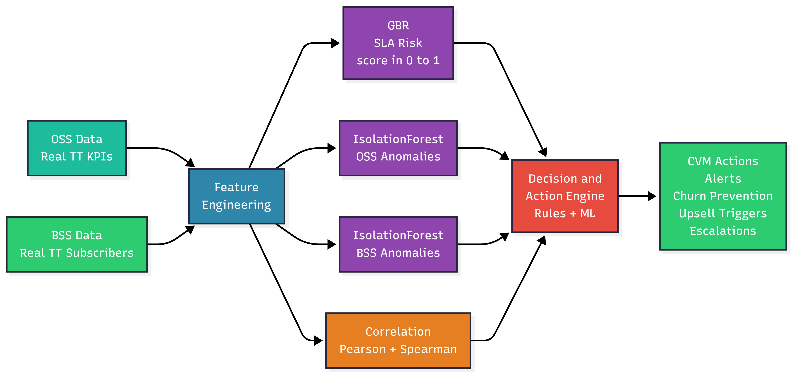
The Intelligence Layer: AI Models
M1 · SLA Risk Prediction
M2 · Network Anomaly
M3 · Revenue Anomaly
M4 · O+B Correlation
GradientBoosting
IsolationForest
IsolationForest
Pearson + Spearman
How likely is SLA breach?
Is this cell behaving abnormally?
Is revenue dropping unexpectedly?
What does network do to revenue?
→ Risk score 0→1
→ Anomaly score
→ Severity 0→1
→ Correlation pairs
All model outputs feed into the Decision & Action Engine → Typed, prioritised CVM actions
[ Diagram #5 — ML Pipeline with Action Engine ]

Slide 6
The Action Engine — What Makes Us ADN L4
Analytics (L3): AI recommends → human decides everything | Autonomous Agent (L4): AI decides AND acts — human handles edge cases only
Decision Rules
Action Lifecycle
SLA Risk > 0.7
→ Proactive Network Alert
CRITICAL
GENERATED
Anomaly + Revenue Drop
→ Churn Prevention Campaign
HIGH
PENDING
Healthy + Revenue Spike
→ Upsell Opportunity
MEDIUM
APPROVED
Cross-domain Correlation
→ Insight Report for CVM
LOW
DISMISSED
Multi-anomaly Same Region
→ Escalation Ticket
CRITICAL

Slide 7
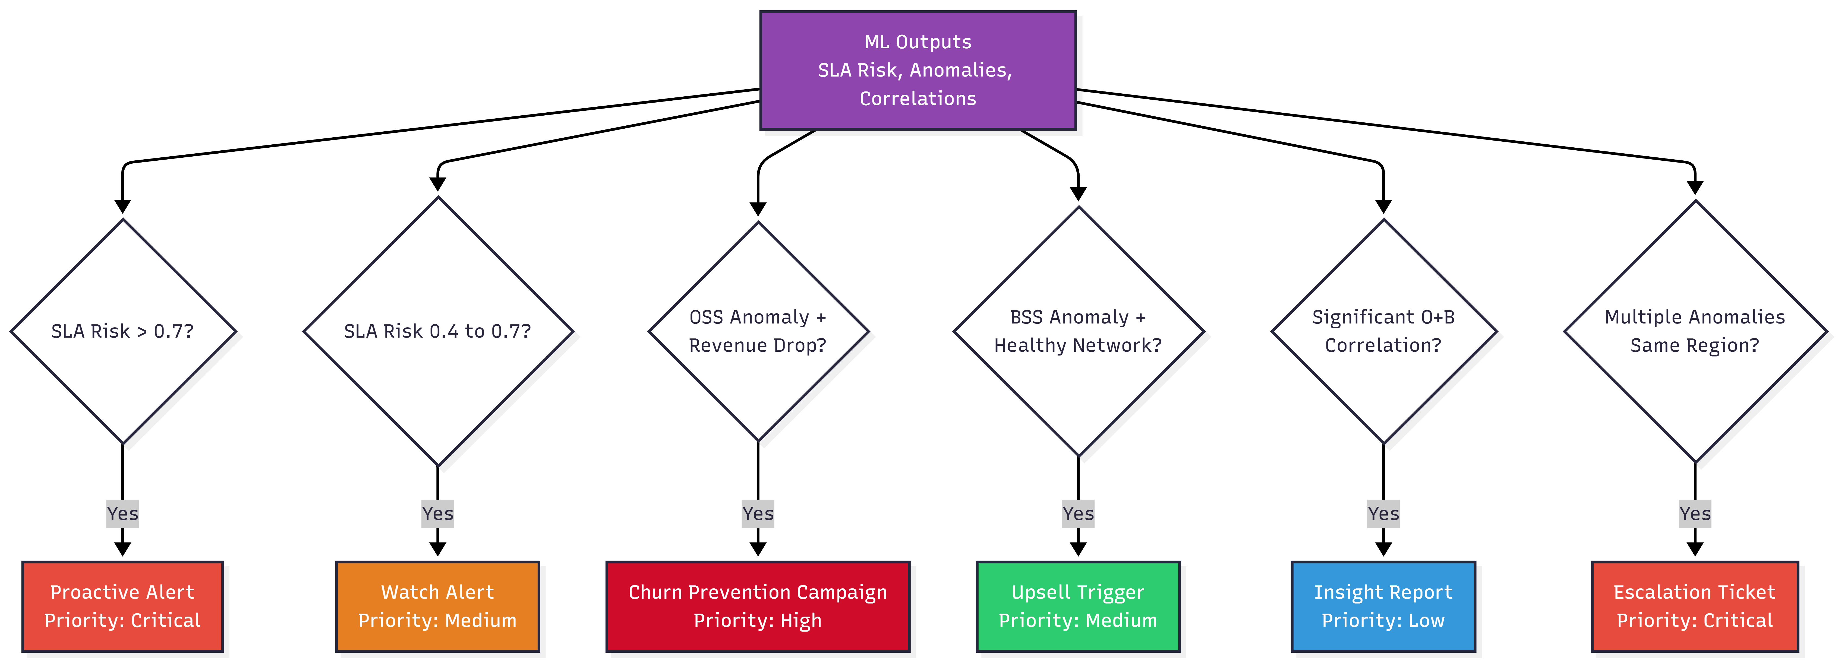
The Action Engine — What Makes Us ADN L4

Slide 8




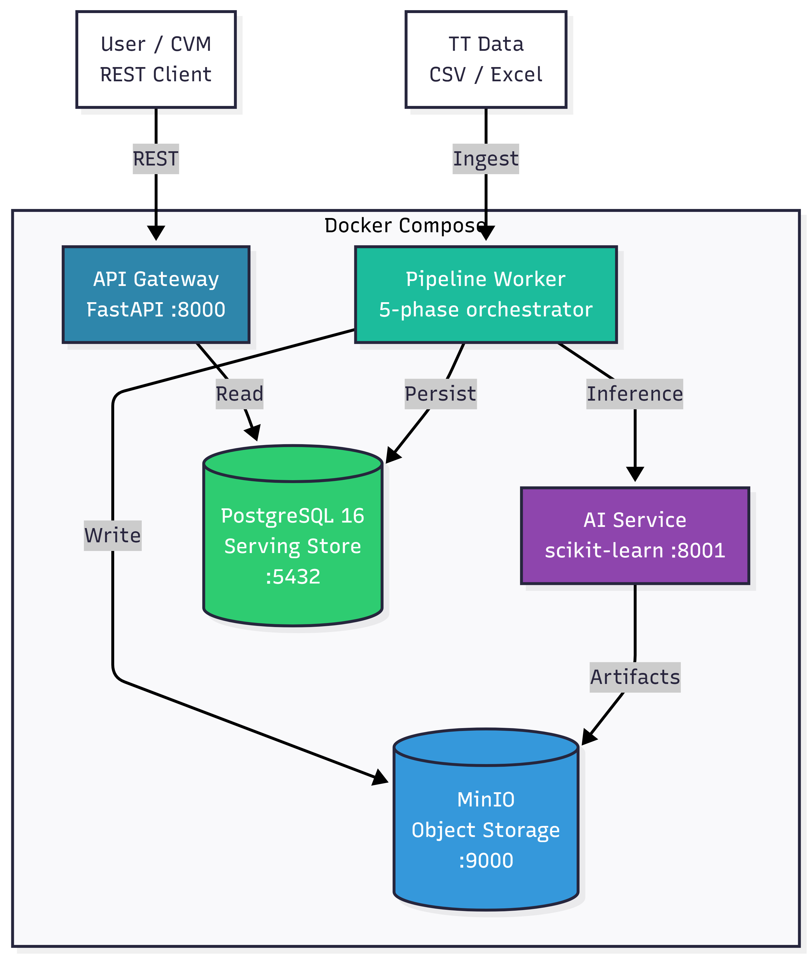
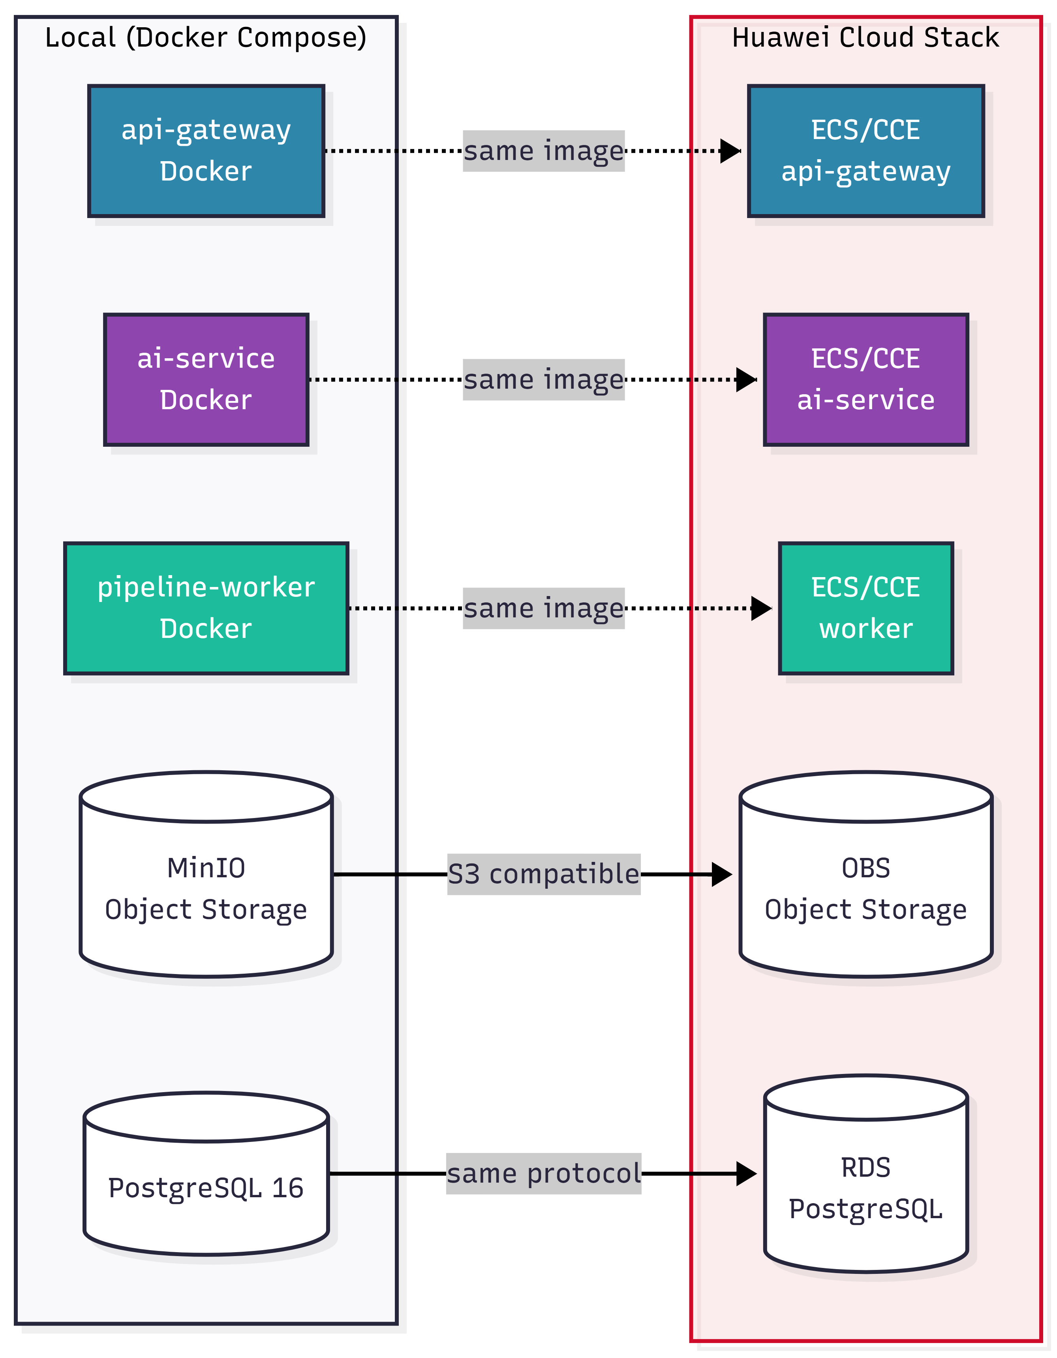
Architecture Overview: 5-Service Cloud-Native Stack
API Gateway
AI Service
Pipeline Worker
PostgreSQL
MinIO
REST Interface
ML Models
5-Phase Orchestrator
Structured Store
3-Layer Data Lake
Cloud-Portable: same images deploy to Huawei Cloud Stack | Docker → ECS · MinIO → OBS · PostgreSQL → RDS · VPC · ELB
[ Diagram #2 — Container Architecture ]
[ Diagram #8 — HCS Mapping ]

Slide 9
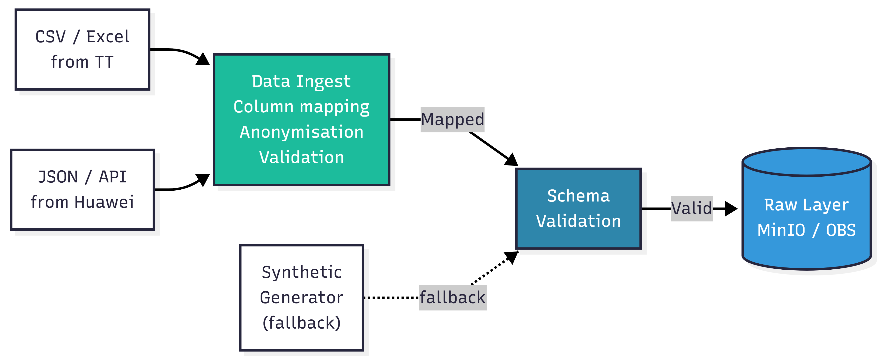
Data: Real Operator, Real Results
Tunisie Telecom — Data Sources
OSS — Network KPIs
cell_id · timestamp · region
throughput_mbps · latency_ms
packet_loss_pct · active_users
rsrp_dbm · alarm_severity
BSS — Subscriber Data
subscriber_id · operator · line_type
[ Diagram #6 — Data Ingestion Flow ]
plan · revenue_tnd · churn_flag
data_usage_gb · voice_min · sms
appu_tnd · dou_gb · complaints
Privacy: SHA-256 MSISDN hash · No PII · Gouvernorat-level only · Dual-mode: Real (default) | Synthetic (fallback)

Slide 10
What Makes Us Different: Competitive Positioning
Solution
Real Data
O+B Fusion
Cloud-Native
Auto Actions
Telecom-Specific
SELFNET
✗
✗
✗
✓
✓
ETSI ZSM
✗
✓
✗
✓
✗
Nokia AVA
✓
✗
✓
✗
✓
Huawei SmartCare
✓
✗
✓
✗
✓
This Project ★
✓
✓
✓
✓
✓
Only this project combines: Real Data + O+B Convergence + Cloud-Native + Autonomous Actions

Slide 11


Outputs & Deliverables So Far
Running Docker Stack
3 Trained ML Models
Decision & Action Engine
3-Layer Data Lake
5 services · One-command deploy
On real Tunisie Telecom data
Typed, prioritised recommendations
Raw · Processed · Curated (MinIO)
REST API
8-Table PostgreSQL Schema
HCS-Ready Architecture
Documentation
12 endpoints for results + actions
Full pipeline lineage via run_id
Docker → ECS · OBS · RDS · VPC
Technical report + architecture docs

Slide 12
Next Steps
Thank You
Immediate
Finalise action engine rules with Huawei team feedback
Questions & Discussion
Short-term
Deploy to Huawei Cloud Stack (HCS) environment
Cloud-Native AI Operations Agent
for CEM–CVM Intelligence
Medium-term
Real-time streaming · Advanced ML (LSTM, Transformers)
Student:
Souhayl Guenichi
Institution:
ESPRIT — Engineering Cycle
Long-term
Reinforcement learning · Path toward ADN L5
Host:
Huawei Tunisia — Cloud IT / Sales-Solution
Year:
2025–2026
PFE 2025–2026
ADN L4 — Highly Autonomous

